Slide 1
Relational DBs & the SQL language
Demystifying Computing
with
Python
{‘auth’:[‘ap’, ‘ss’, ‘da’, `am’]}

Slide 2
This unit:
SELECT Pizza
FROM Freezer
WHERE Pepperoni = 10
AND Olives = ‘Black’
Introduction to structured vs. unstructured data, relational databases.
1. Introduction to Database Management systems
Some theory on databases
2. Introduction to SQL and SQL by Python

Slide 3
Data organisation
Structured data
Clearly defined data types
A data model (called schema) defines the data
Data type (e.g. integer), data format (e.g. +44 (079) 444 4444
Data model defines rules and constraints!
E.g. salary should be >0, first name cannot be empty etc.
Unstructured data
Internal structure is not pre defined
There is no data model

Slide 4

Structured vs Unstructured data
Structured data resides in relational databases:
a database structured to recognise relations between stored items of data
Unstructured data is everything else!
Text files, emails, websites, media, social media etc.

Slide 5
In detail … Structured data
Clearly defined data types
Designed in a way to be easy to search data
Usually stored in relational databases
Relational database management systems (RDBMS)
Fields (column titles) easy to manage using constraints
To interact with RDBMS we use the Structured Query Language (SQL)
Extract and manipulate data based on queries
the top programming language by mentions in job adverts for technical positions [IEEE Spectrum, Aug. 2023]

Slide 6
In detail … Unstructured data
Have some internal structure
There is no clear data model
It could be difficult to search
Unstructured data stored in NoSQL database systems.
Examples:
Text files
Emails

Slide 7
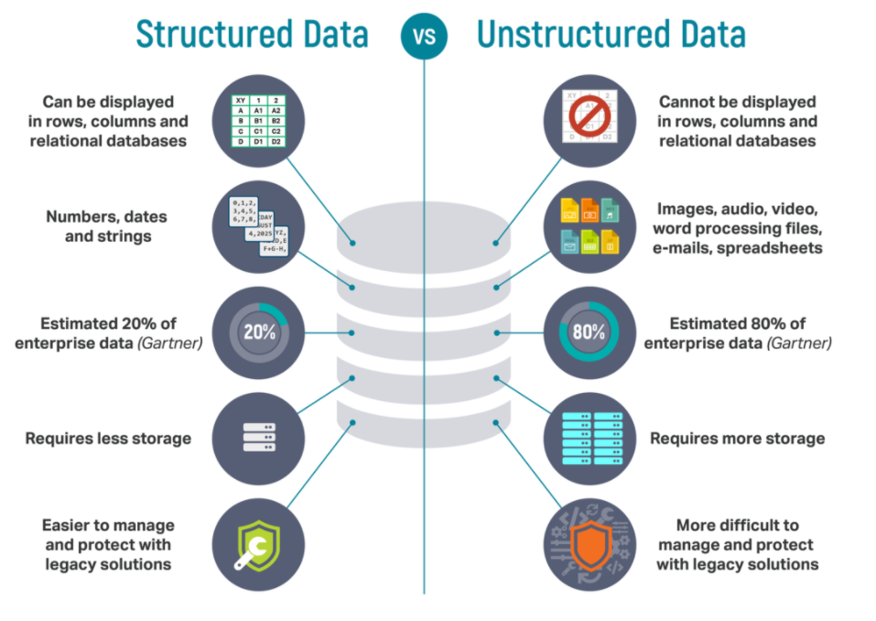
Structured vs Unstructured

Slide 8
Semi-structured data
Semi-structured data is a form of structured data that does not obey the formal structure of data models associated with relational databases or other forms of data tables, but nonetheless contains tags or other markers to separate semantic elements and enforce hierarchies of records and fields within the data. [Wikipedia]
Examples:
JSON
XML
NoSQL systems: Ideally systems to store Semi-structured data

Slide 9
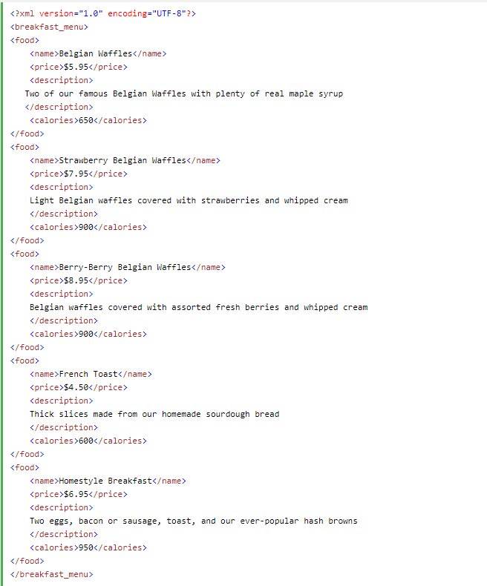
Example of XML file
Extensible Markup Language (XML) is a markup language that defines a set of rules for encoding documents in a format that is both human-readable and machine-readable.
Source: https://en.wikipedia.org/wiki/XML

Slide 10
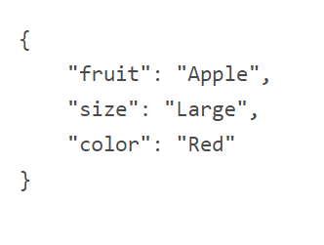
Example of JSON file
In computing, JavaScript Object Notation (JSON) (/ˈdʒeɪsən/ "Jason"[1][2]) is an open-standard file
format that uses human-readable text to transmit data objects consisting of attribute–value pairs
and array data types (or any other serializable value).
Source: https://en.wikipedia.org/wiki/JSON

Slide 11
Summary
Structured data:
Examples:
Airline reservation system
Inventory control
Semi-structured data:
Examples:
Data generated from systems
Data collected from a pulse monitoring device
Unstructured data:
Examples:
Email clients
Word processing documents
Logs and reports

Slide 12
Relational databases: a logical view
Attribute
User_id | Fname | Lname | Phone
1001 | Stelios | Sotiriadis | 07912341234
1002 | Niki | Andrea | 07976543421
1003 | George | Martin | 07912341234
data is structured in tables
intuitive organisation
easier to control/search
more restrictive and less ad hoc/ambigous
than arbitrary spreadsheet tables
table is defined as a 2-D data structure with rows (records) and columns (attributes/labels)
the attributes row (aka schema) is special: names must be unique & have fixed data type
a relational database is a set of such tables
record

Slide 13
Table characteristics
A table includes attributes:
Keys
Primary Key (PK): An attribute that uniquely identifies any given entity (row of record)
Keys are used in all systems
Passport ID
NINO
NHS Number
Key characteristics:
Cannot be empty for a record (Not Null)
Has to be unique!
No duplicated values are allowed.
It’s very useful when you create relationships between tables
Helps to avoid redundancy (records that are repeated)

Slide 14
What is a schema (data model) ?
A data model (or datamodel) is an abstract model that organizes elements of data and standardizes how they relate to one another and to the properties of real-world entities.
[Source]
Example: there is a canonical, almost immutable Relational schema to describe a university.
Typical tables are Students, Modules/Classes, Completed exams, Graduates, Instructors
There are dozens of relational database instances, sometimes hosted in the same server/cloud:
You are into the unimi.it instance.

Slide 15
What’s wrong with this table?
Book_ID | Book_Title | Book_Author | Author_Address | Authors_Phone_Number
1 | Hobbit | Tolkien | Bournemouth | 01202 345234
2 | LOTR 1 | Tolkien | Bournemouth | 01202 345234
3 | LOTR 2 | Tolkien | Bournemouth | 01202 345234
4 | LOTR 3 | Tolkien | Bournemouth | 01202 345234
5 | The Silmarillion | Tolkien | Bournemouth | 01202 345234
5 rows * 5 columns = 25 data

Slide 16

Quiz 1: Can we redesign it?
Produce a better design.
Define ”better”…
Book_ID | Book_Title | Book_Author | Author_Address | Authors_Phone_Number
1 | Hobbit | Tolkien | Bournemouth | 01202 345234
2 | LOTR 1 | Tolkien | Bournemouth | 01202 345234
3 | LOTR 2 | Tolkien | Bournemouth | 01202 345234
4 | LOTR 3 | Tolkien | Bournemouth | 01202 345234
5 | The silmarillion | Tolkien | Bournemouth | 01202 345234

Slide 17
Designing a “better” data model
These are the same…
Book_ID | Book_Title | Author_ID
1 | Hobbit | A1
2 | LOTR 1 | A1
3 | LOTR 2 | A1
4 | LOTR 3 | A1
5 | The silmarillion | A1
5 rows * 3 columns = 15 data
1 row * 4 columns = 4 data
19 data
(less data…)
Author_ID | Book_Author | Author_Address | Authors_Phone_Number
A1 | Tolkien | Bournemouth | 01202 345234

Slide 18
Database creation
A database is an organized collection of structured information, or data, typically stored electronically in a computer system.
A database is usually controlled by a (heavy) software called database management system (DBMS).
Together, the data and the DBMS, along with the applications that are associated with them, are referred to as a database system, often shortened to just database.
[Source]

Slide 19
Popular RDBMSs
IBM DB2
Oracle
Microsoft SQL Server
MySQL
PostgreSQL
SQLite: a Python port
MongoDB: not a SQL database
Check the updated rankings

Slide 20
What is SQL
SQL (pronounced "ess-que-el") stands for Structured Query Language.
SQL is used to communicate with a database.
SQL provides a set of commands to interact with a database system.

Slide 21
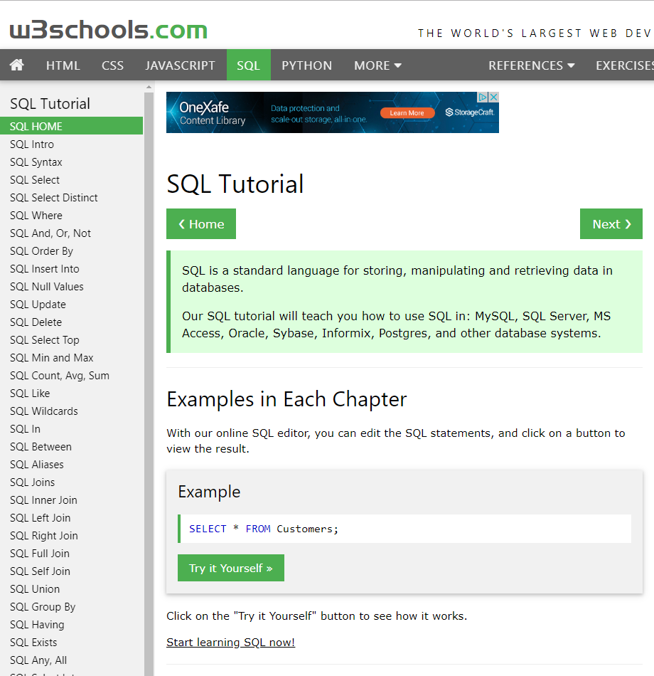
Create a database
Create a database
CREATE DATABASE bl_data;
Delete a database
DROP DATABASE bl_data;

Slide 22
Create a new table
We want to store data about urban areas
city_id will be numeric (Integer) and my primary key
No duplicates/Not Null values
name will be string (characters), in SQL called varchar!
Also, the size of the name could be up to 24 characters…
name, cannot be empty in my table!
country will be a varchar, up to 2 characters
E.g. UK, US, GR, NL etc.
Table Name: Cities
city_id | name | country
1 | London | GB
2 | New York City | US
Test it on w3schools!
SQL> CREATE TABLE cities (city_id INTEGER PRIMARY KEY,
name VARCHAR(24) NOT NULL,
country VARCHAR(2)
);

Slide 23
SQL Datatypes
VARCHAR(size):
A VARIABLE length string (can contain letters, numbers, and special characters). The size parameter specifies the maximum column length in characters - can be from 0 to 65535
TEXT
A field with a maximum length of 65535 characters
INTEGER(M):
M is optional, and denotes the display length.
A medium integer. Signed range is from -2147483648 to 2147483647. Unsigned range is from 0 to 4294967295.
FLOAT(M,D)
A floating-point number that cannot be unsigned. You can define the display length (M) and the number of decimals (D).

Slide 24
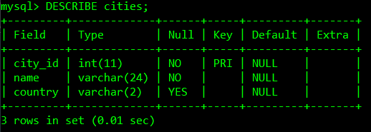
SQL Describe a table to see internal structure
DESCRIBE cities;

Slide 25
SQL Insert data
RDBMSs allow slightly different INSERT commands
MySQL use the following:
INSERT INTO cities (city_id, name, country) VALUES (1,'London','GB');
INSERT INTO cities (city_id, name, country) VALUES (2,'New York City','US');

Slide 26
SQL Insert data, 2
When used from inside Python, PostgreSQL use the following:
"""INSERT INTO cities (city_id, name, country)
VALUES (%s, %s, %s)""",
(2,'New York City','US')

Slide 27

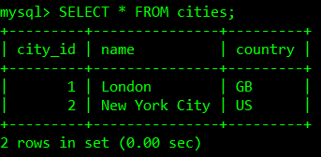
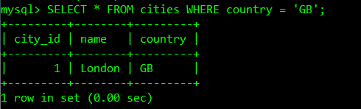
Select data
The SELECT statement is used to select data from a database.
Table Name: cities
city_id | name | country
1 | London | GB
2 | New York City | US
SELECT *
FROM cities
WHERE country = 'GB';
SELECT * FROM cities;

Slide 28
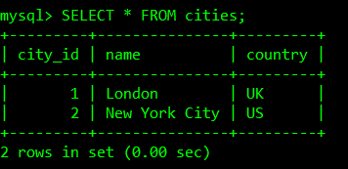
Update data
UPDATE cities SET country='UK' WHERE city_id=1;
SQL> SELECT * FROM cities;

Slide 29
Quiz! Let’s create another table
Cannot be empty
writer_id | writer_fname | writer_lname | writer_gender | writer_birth_year
100 | Agatha | Christie | F | 1890
101 | J.R.R. | Tolkien | M | 1892
102 | Charles | Dickens | M | 1812
103 | J.K. | Rowling | F | 1965
CREATE TABLE writers ( writer_id INTEGER PRIMARY KEY, writer_fname VARCHAR(24) NOT NULL, writer_lname varchar(24) NOT NULL, writer_gender varchar(1), writer_birth_year INTEGER
);

Slide 30
Insert data by the row
INSERT INTO WRITERS (WRITER_ID, WRITER_FNAME, WRITER_LNAME, WRITER_GENDER, WRITER_BIRTH_YEAR)
VALUES (100, 'AGATHA','CHRISTIE','F',1890);
INSERT INTO WRITERS (WRITER_ID, WRITER_FNAME, WRITER_LNAME, WRITER_GENDER, WRITER_BIRTH_YEAR)
VALUES (101, 'J.R.R.','TOLKIEN','M',1892);
INSERT INTO WRITERS (WRITER_ID, WRITER_FNAME, WRITER_LNAME, WRITER_GENDER, WRITER_BIRTH_YEAR)
VALUES (105, 'Rowland','Atkinson', NULL, NULL);

Slide 31

Insert several rows
INSERT INTO writers (writer_id, writer_fname, writer_lname, writer_gender, writer_birth_year)
VALUES (100, 'Agatha','Christie','F',1890),
(101, 'J.R.R.','Tolkien','M',1892),
(102, 'Charles','Dickens','M',1812),
(103,'J.K.', 'Rowling','F',1965);

Slide 32
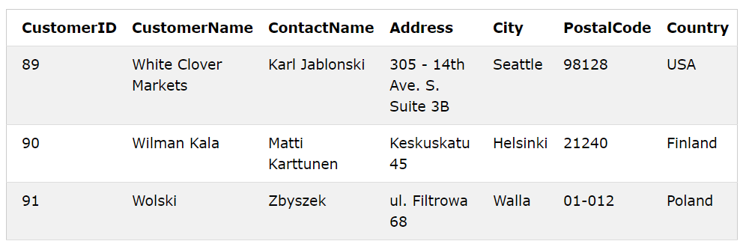
Quiz
Let us assume that we have a customers table
Identify the customers primary key
What is the data type of CustomerName?
What is the data type of Address?

Slide 33
Quiz solution
Let us assume that we have a customers table
Identify the customers primary key: CustomerID
What is the data type of CustomerName? VARCHAR(25)
What is the data type of Address? TEXT

Slide 34
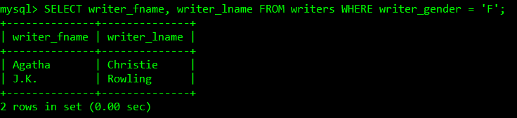
Select data using WHERE clause to filter records
SELECT writer_fname, writer_lname
FROM writers
WHERE writer_gender = 'F';
writer_id | writer_fname | writer_lname | writer_gender | writer_birth_year
100 | Agatha | Christie | F | 1890
101 | J.R.R. | Tolkien | M | 1892
102 | Charles | Dickens | M | 1812
103 | J.K. | Rowling | F | 1965

Slide 35
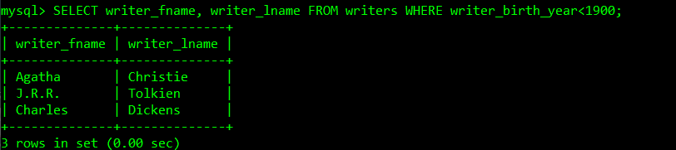
Select data using WHERE clause to filter records cont.
SELECT writer_fname, writer_lname
FROM writers
WHERE writer_birth_year<1900;
writer_id | writer_fname | writer_lname | writer_gender | writer_birth_year
100 | Agatha | Christie | F | 1890
101 | J.R.R. | Tolkien | M | 1892
102 | Charles | Dickens | M | 1812
103 | J.K. | Rowling | F | 1965

Slide 36
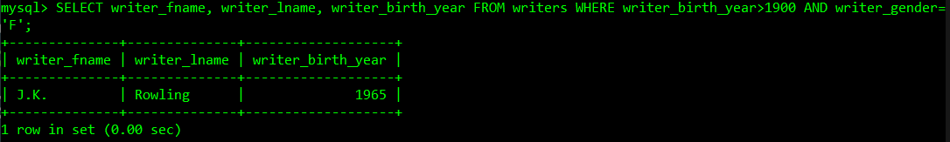
Select data using where and logical condition
SELECT writer_fname, writer_lname, writer_birth_year
FROM writers WHERE writer_birth_year>1900 AND writer_gender='F';
writer_id | writer_fname | writer_lname | writer_gender | writer_birth_year
100 | Agatha | Christie | F | 1890
101 | J.R.R. | Tolkien | M | 1892
102 | Charles | Dickens | M | 1812
103 | J.K. | Rowling | F | 1965

Slide 37
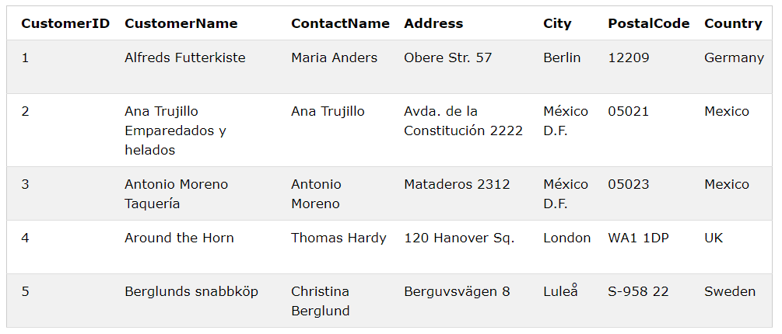
Quiz: the "Customers" table
Select "CustomerName" and "City“
Select data on from customers living in Berlin

Slide 38
Quiz solution
Select the "CustomerName" and "City" columns from the "Customers" table.
Select all the data from customer name, address and city for customers living in Berlin.
SELECT CustomerName, City
FROM customers;
2. SELECT CustomerName, Address
FROM customers
WHERE City=‘Berlin’;

Slide 39
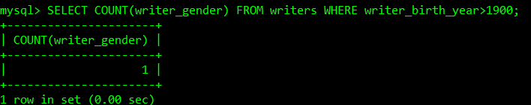
Count data using count function
SELECT COUNT(writer_gender)
FROM writers
WHERE writer_birth_year>1900;
writer_id | writer_fname | writer_lname | writer_gender | writer_birth_year
100 | Agatha | Christie | F | 1890
101 | J.R.R. | Tolkien | M | 1892
102 | Charles | Dickens | M | 1812
103 | J.K. | Rowling | F | 1965

Slide 40
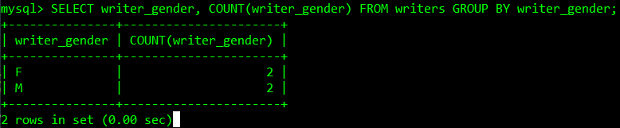
More on Select data
The “GROUP BY” statement, groups rows that have the same values into summary rows:
“count the number of genders".
SELECT writer_gender, COUNT(writer_gender)
FROM writers
GROUP BY writer_gender;
writer_id | writer_fname | writer_lname | writer_gender | writer_birth_year
100 | Agatha | Christie | F | 1890
101 | J.R.R. | Tolkien | M | 1892
102 | Charles | Dickens | M | 1812
103 | J.K. | Rowling | F | 1965

Slide 41
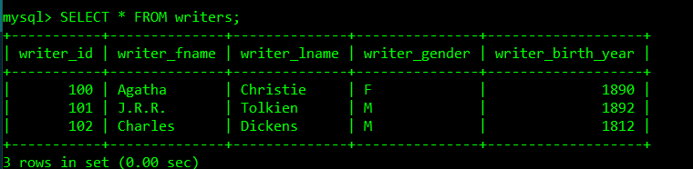
Delete data by filtering records
DELETE FROM writers
WHERE writer_birth_year=1965;
writer_id | writer_fname | writer_lname | writer_gender | writer_birth_year
100 | Agatha | Christie | F | 1890
101 | J.R.R. | Tolkien | M | 1892
102 | Charles | Dickens | M | 1812
103 | J.K. | Rowling | F | 1965
SQL> SELECT * FROM writers;

Slide 42
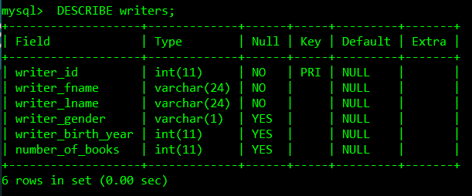
ALTER TABLE: Change the structure (schema)
ALTER TABLE writers ADD number_of_books INTEGER;
SQL> DESCRIBE writers;

Slide 43
Let’s add new values (update…)
UPDATE writers
SET number_of_books=73
WHERE writer_id=100;
UPDATE writers
SET number_of_books=26
WHERE WRITER_ID=101;
UPDATE writers
SET number_of_books=20
WHERE writer_id=102;

Slide 44
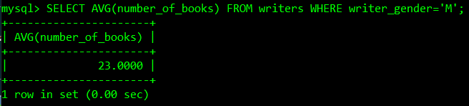
The AVG() function returns the average value of a numeric column.
SELECT AVG(number_of_books) FROM writers WHERE writer_gender='M';
writer_id | writer_fname | writer_lname | writer_gender | writer_birth_year | number_of_books
100 | Agatha | Christie | F | 1890 | 73
101 | J.R.R. | Tolkien | M | 1892 | 26
102 | Charles | Dickens | M | 1812 | 20

Slide 45
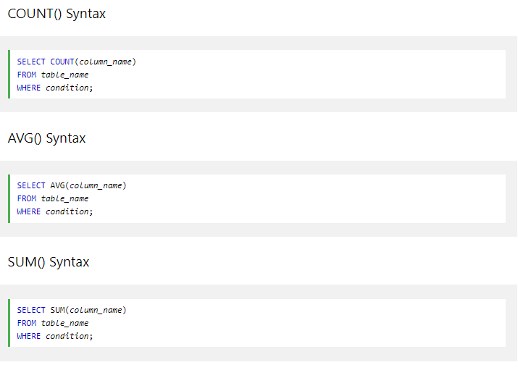
Summary on SQL functions

Slide 46
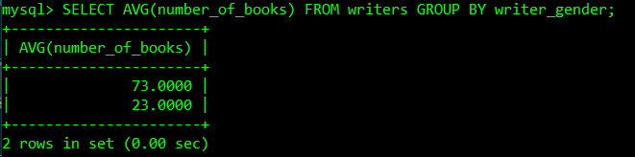
Combine function with a group by…
SELECT AVG(number_of_books)
FROM writers
GROUP BY writer_gender;
writer_id | writer_fname | writer_lname | writer_gender | writer_birth_year | number_of_books
100 | Agatha | Christie | F | 1890 | 73
101 | J.R.R. | Tolkien | M | 1892 | 26
102 | Charles | Dickens | M | 1812 | 20

Slide 47
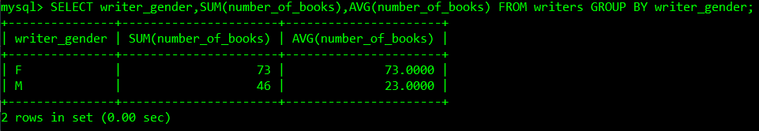
More on select…
SELECT writer_gender,SUM(number_of_books), AVG(number_of_books) FROM writers GROUP BY writer_gender;
writer_id | writer_fname | writer_lname | writer_gender | writer_birth_year | number_of_books
100 | Agatha | Christie | F | 1890 | 73
101 | J.R.R. | Tolkien | M | 1892 | 26
102 | Charles | Dickens | M | 1812 | 20

